Slide 1
1.4 Inverses;
Rules of Matrix Arithmetic

Slide 2
Properties of Matrix Operations
For real numbers a and b ,we always have ab=ba, which is called the commutative law for multiplication. For matrices, however, AB and BA need not be equal.
Equality can fail to hold for three reasons:
  The product AB is defined but BA is undefined.
  AB and BA are both defined but have different sizes.
  it is possible to have AB=BA even if both AB and BA are defined and have the same size.

Slide 3
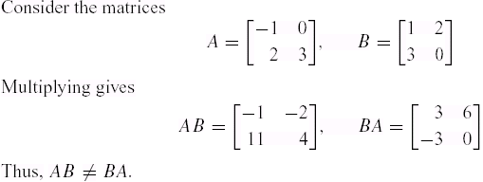
Example1
AB and BA Need Not Be Equal

Slide 4
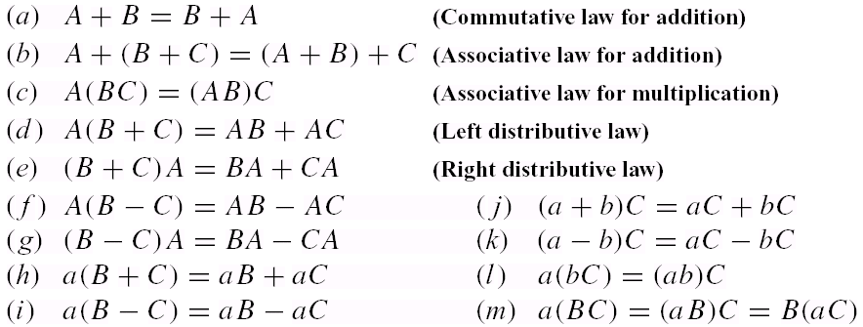
Theorem 1.4.1
Properties of Matrix Arithmetic
Assuming that the sizes of the matrices are such that the indicated operations can be performed, the following rules of matrix arithmetic are valid:

Slide 5
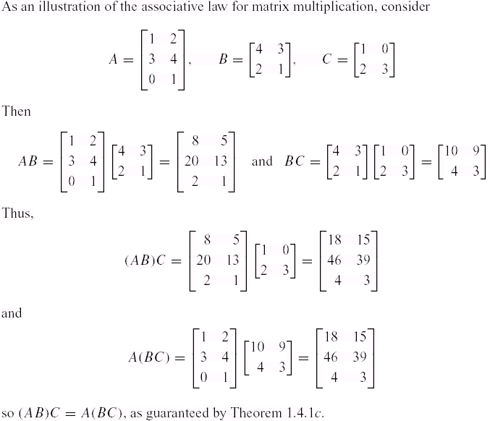
Example2
Associativity of Matrix Multiplication

Slide 6
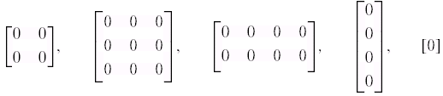

Zero Matrices
A matrix, all of whose entries are zero, such as
is called a zero matrix .
A zero matrix will be denoted by 0 ;if it is important to emphasize the size, we shall write for the m×n zero matrix. Moreover, in keeping with our convention of using boldface symbols for matrices with one column, we will denote a zero matrix with one column by 0 .

Slide 7
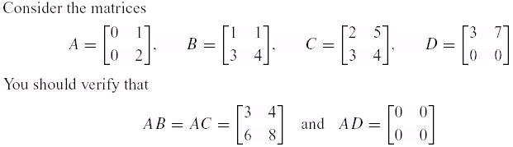
Example3
The Cancellation Law Does Not Hold
Although A≠0 ,it is incorrect to cancel the A from both sides of
the equation AB=AC and write B=C .
Also, AD=0 ,yet A≠0 and D≠0 .
Thus, the cancellation law is not valid for matrix multiplication,
and it is possible for a product of matrices to be zero without
either factor being zero.
Recall the arithmetic of real numbers :

Slide 8

Theorem 1.4.2
Properties of Zero Matrices
Assuming that the sizes of the matrices are such that the indicated operations can be performed ,the following rules of matrix arithmetic are valid.

Slide 9
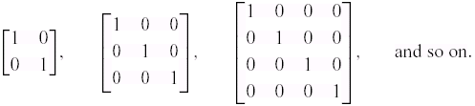

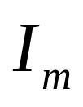
Identity Matrices
Of special interest are square matrices with 1’s on the main diagonal and 0’s off the main diagonal, such as
A matrix of this form is called an identity matrix and is denoted by I .If it is important to emphasize the size, we shall write for the n×n identity matrix.
If A is an m×n matrix, then
A = A and A = A
Recall : the number 1 plays in the numerical relationships
a・1 = 1 ・a = a .

Slide 10
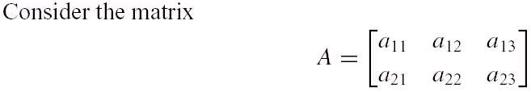
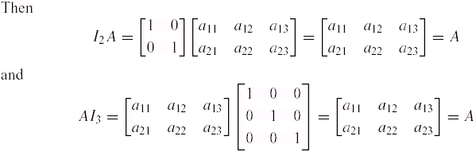
Example4
Multiplication by an Identity Matrix
Recall : A = A and A = A , as A is an m×n matrix

Slide 11
Theorem 1.4.3
If R is the reduced row-echelon form of an n×n matrix A, then either R has a row of zeros or R is the identity matrix .

Slide 12

Definition
If A is a square matrix, and if a matrix B of the same size can be found such that AB=BA=I , then A is said to be invertible and B is called an inverse of A . If no such matrix B can be found, then A is said to be singular .
Notation:

Slide 13
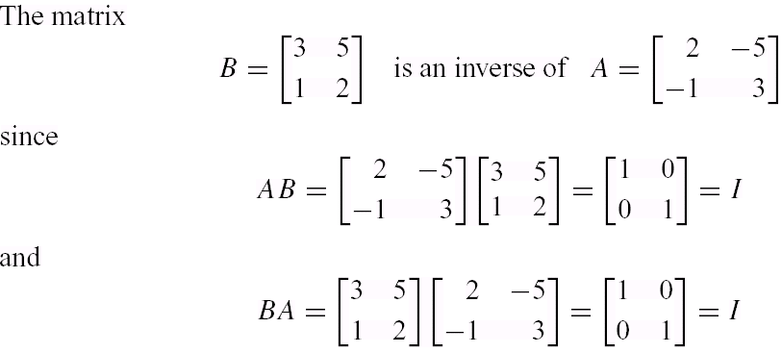
Example5
Verifying the Inverse requirements

Slide 14
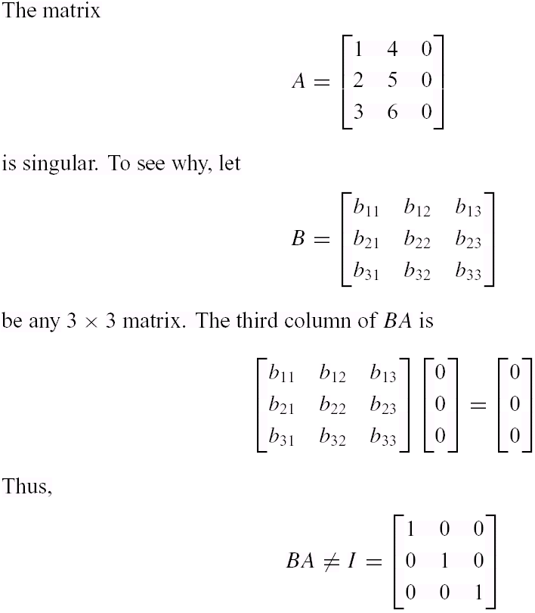
Example6
A Matrix with no Inverse

Slide 15
Properties of Inverses
It is reasonable to ask whether an invertible matrix can have more than one inverse. The next theorem shows that the answer is no  an invertible matrix has exactly one inverse .
Theorem 1.4.4
Theorem 1.4.5
Theorem 1.4.6

Slide 16
Theorem 1.4.4
If B and C are both inverses of the matrix A, then B=C .

Slide 17
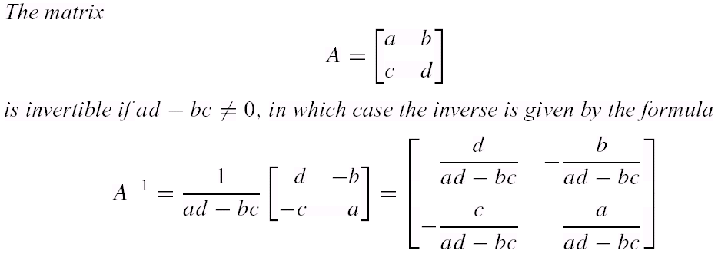
Theorem 1.4.5

Slide 18
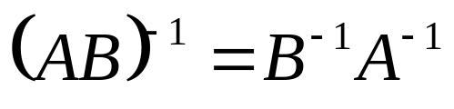
Theorem 1.4.6
If A and B are invertible matrices of the same size ,then AB is invertible and
  The result can be extended :

Slide 19
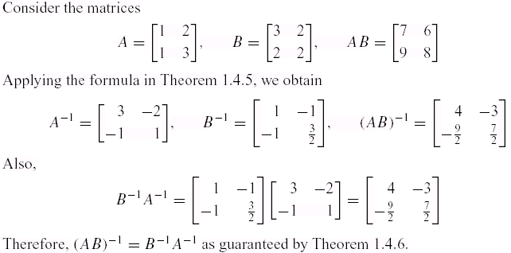
Example7
Inverse of a Product

Slide 20
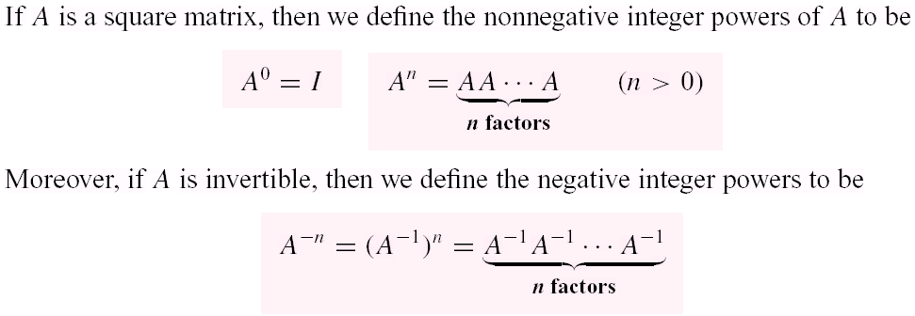
Definition

Slide 21
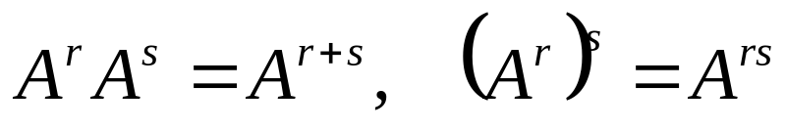
Theorem 1.4.7
Laws of Exponents
If A is a square matrix and r and s are integers ,then

Slide 22
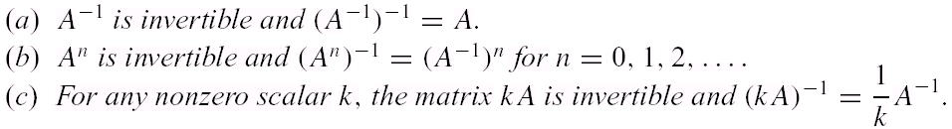
Theorem 1.4.8
Laws of Exponents
If A is an invertible matrix ,then :

Slide 23
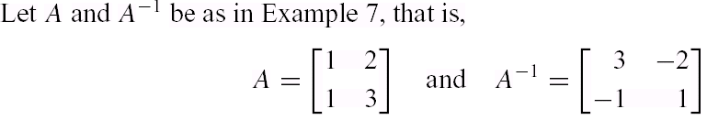
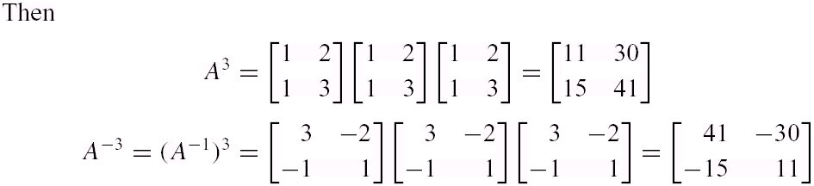
Example8
Powers of a Matrix

Slide 24
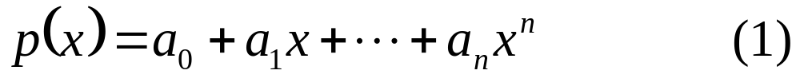
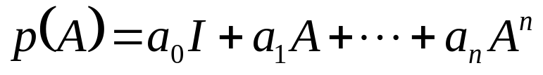

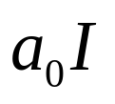
Polynomial Expressions Involving Matrices
If A is a square matrix, say m×m, and if
is any polynomial, then w define
where I is the m×m identity matrix.
In words, p(A) is the m×m matrix that results when A is substituted for x in (1) and
is replaced by .

Slide 25
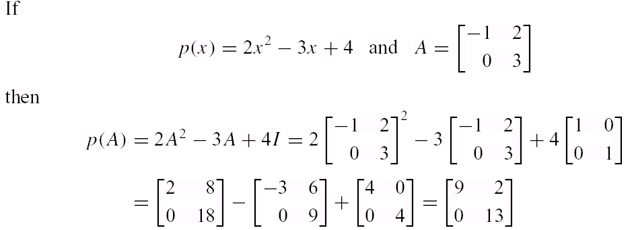
Example9
Matrix Polynomial

Slide 26
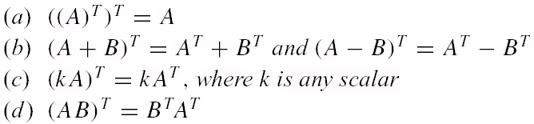
Theorem 1.4.9
Properties of the Transpose
If the sizes of the matrices are such that the stated operations can be performed ,then
  Part (d) of this theorem can be extended :

Slide 27

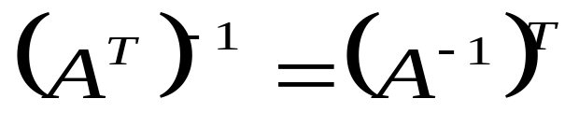
Theorem 1.4.10
Invertibility of a Transpose
If A is an invertible matrix ,then is also invertible and

Slide 28
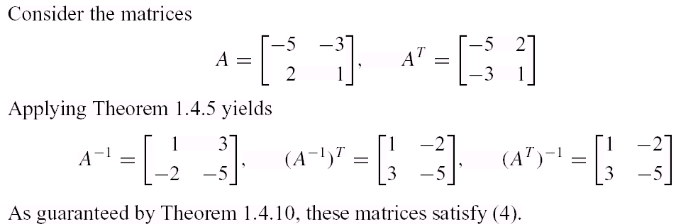
Example 10
Verifying Theorem 1.4.10

Slide 29
1.5 Elementary Matrices and
-1
a Method for Finding A

Slide 30
Definition
An n×n matrix is called an elementary matrix if it can be obtained from the n×n identity matrix by performing a single elementary row operation.

Slide 31
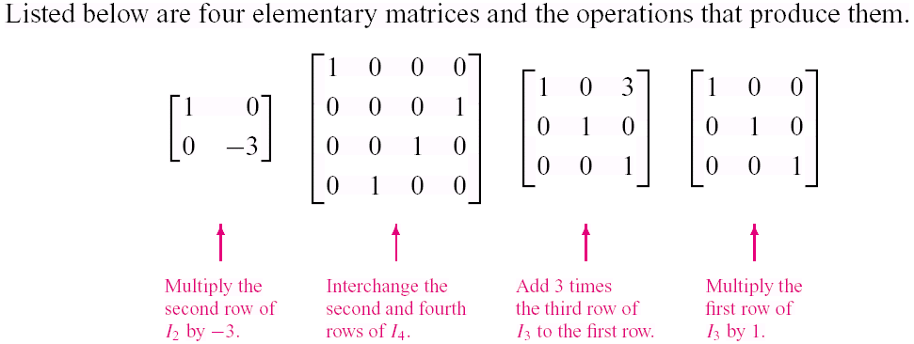
Example1
Elementary Matrices and Row Operations

Slide 32
Theorem 1.5.1
Row Operations by Matrix Multiplication
If the elementary matrix E results from performing a certain row operation on and if A is an m×n matrix ,then the product EA is the matrix that results when this same row operation is performed on A .
  When a matrix A is multiplied on the left by an elementary matrix E ,the effect is to performan elementary row operation on A .

Slide 33
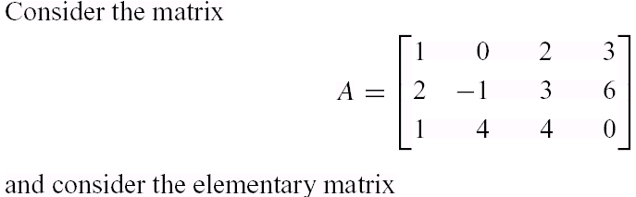
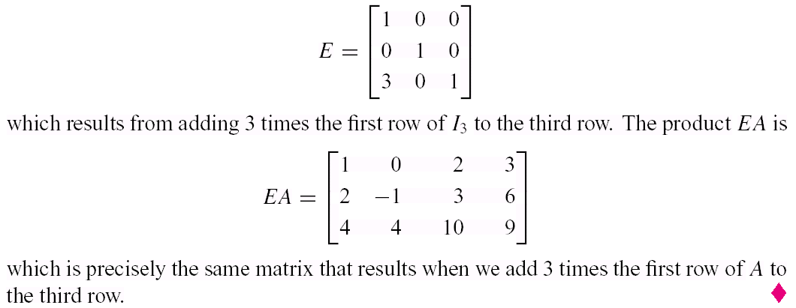
Example2
Using Elementary Matrices

Slide 34
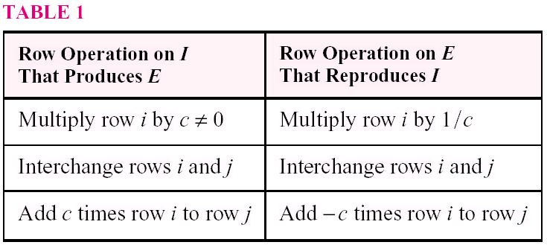
Inverse Operations
If an elementary row operation is applied to an identity matrix I to produce an elementary matrix E ,then there is a second row operation that, when applied to E, produces I back again.
Table 1.The operations on the right side of this table are called the inverse operations of the corresponding operations on the left.

Slide 35
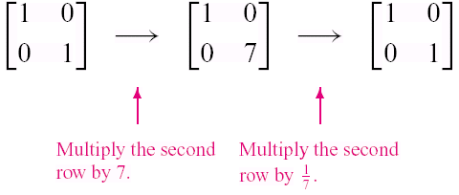
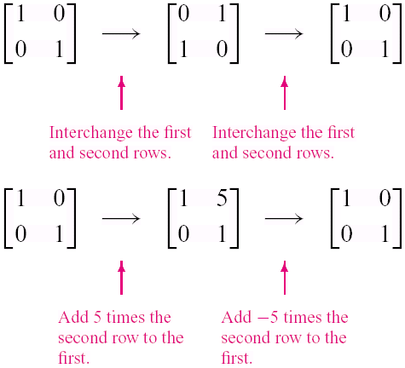
Example3
Row Operations and Inverse Row Operation
The 2 ×2 identity matrix to obtain an elementary matrix E ,then E is restored to the identity matrix by applying the inverse row operation.

Slide 36
Theorem 1.5.2
Every elementary matrix is invertible ,and the inverse is also an elementary matrix.

Slide 37
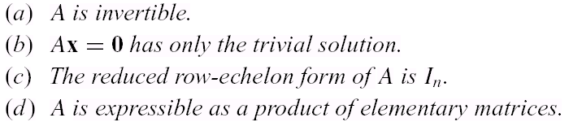
Theorem 1.5.3
Equivalent Statements
If A is an n×n matrix ,then the following statements are equivalent ,that is ,all true or all false.

Slide 38
Row Equivalence
Matrices that can be obtained from one another by a finite sequence of elementary row operations are said to be row equivalent .
With this terminology it follows from parts (a )and (c ) of Theorem 1.5.3 that an n×n matrix A is invertible if and only if it is row equivalent to the n×n identity matrix.

Slide 39
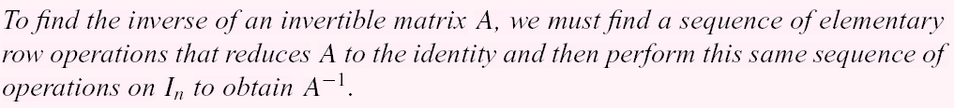
A method for Inverting Matrices

Slide 40
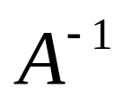
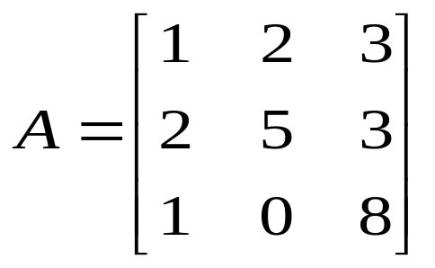
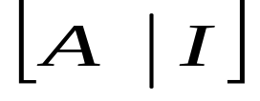
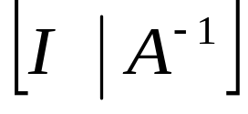
Example4
Using Row Operations to Find (1/3)
Find the inverse of
Solution:
  To accomplish this we shall adjoin the identity
  matrix to the right side of A ,thereby producing a
  matrix of the form
  we shall apply row operations to this matrix until
  the left side is reduced to I ;these operations will
  convert the right side to ,so that the final matrix
  will have the form

Slide 41
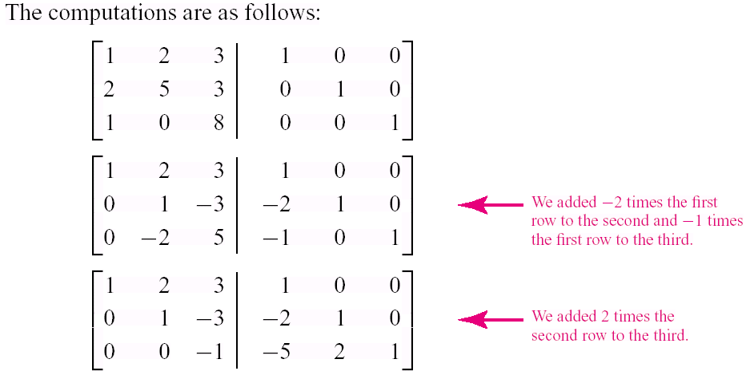
Example4
Using Row Operations to Find (2/3)

Slide 42
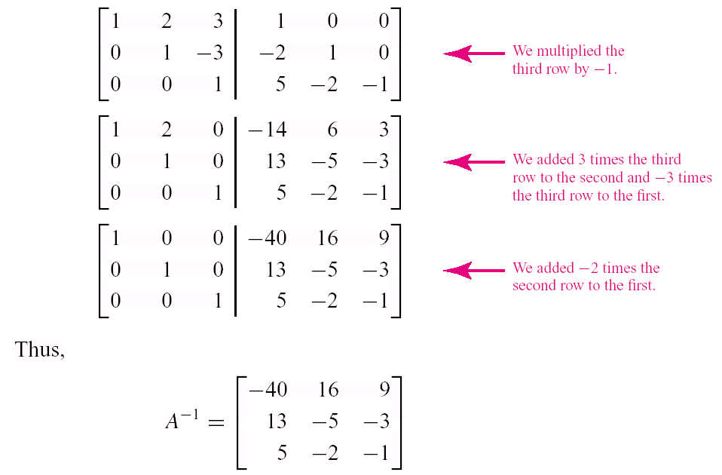
Example4
Using Row Operations to Find (3/3)

Slide 43
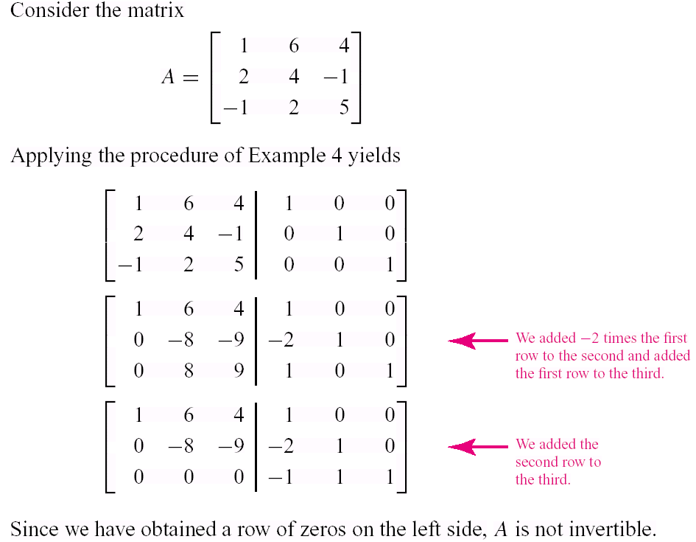
Example5
Showing That a Matrix Is Not Invertible

Slide 44
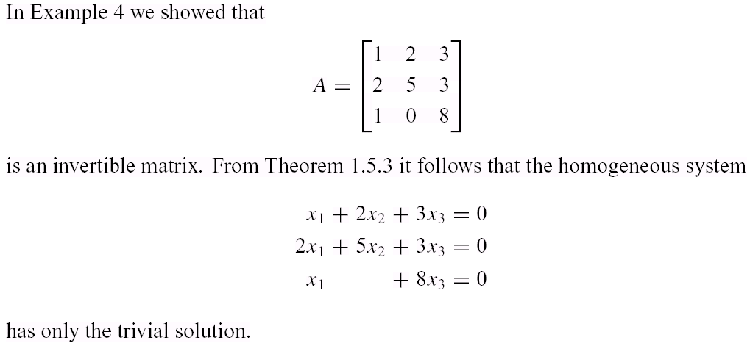
Example6
A Consequence of Invertibility

Slide 45
1.6 Further Results on Systems
of Equations and Invertibility

Slide 46
Theorem 1.6.1
Every system of linear equations has either no solutions ,exactly one solution ,or in finitely many solutions.
  Recall Section 1.1 (based on Figure1.1.1 )

Slide 47
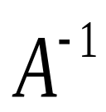
Theorem 1.6.2
If A is an invertible n×n matrix ,then for each n×1 matrix b ,the system of equations A x =b has exactly one solution ,namely ,
x = b .

Slide 48
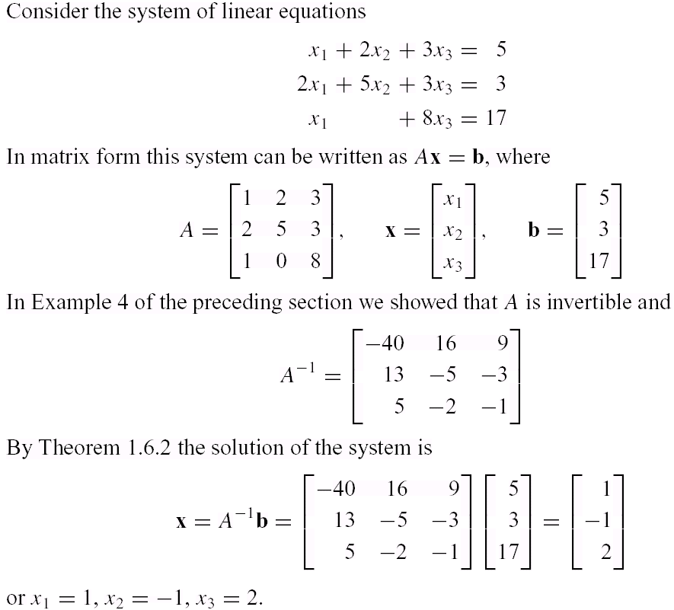
Example1
Solution of a Linear System Using

Slide 49

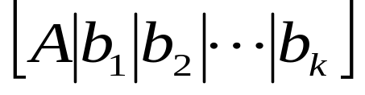
Linear systems with a Common Coefficient Matrix
one is concerned with solving a sequence of systems
Each of which has the same square coefficient matrix A .If A is invertible, then the solutions
A more efficient method is to form the matrix
By reducing(1)to reduced row-echelon form we can solve all k systems at once by Gauss-Jordan elimination.
This method has the added advantage that it applies even when A is not invertible.

Slide 50
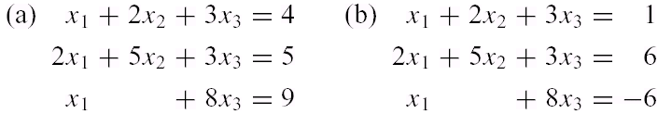
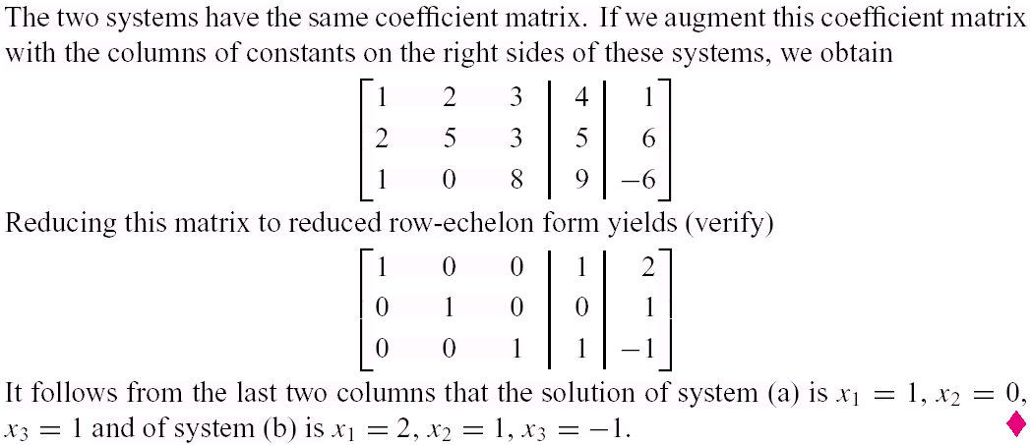
Example2
Solving Two Linear Systems at Once
Solve the systems
Solution

Slide 51
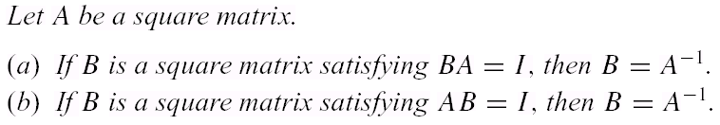
Theorem 1.6.3
Up to now, to show that an n×n matrix A is invertible, it has
been necessary to find an n×n matrix B such that
AB=I and BA=I
We produce an n×n matrix B satisfying either condition,
then the other condition holds automatically.

Slide 52
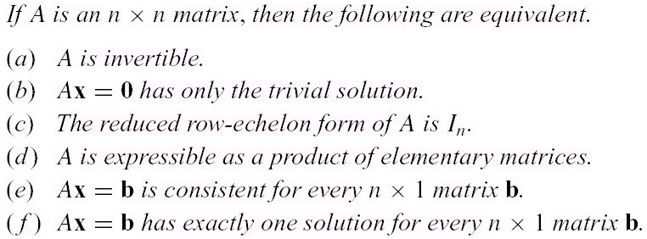
Theorem 1.6.4
Equivalent Statements

Slide 53
Theorem 1.6.5
Let A and B be square matrices of the same size. If AB is invertible ,then A and B must also be invertible.

Slide 54

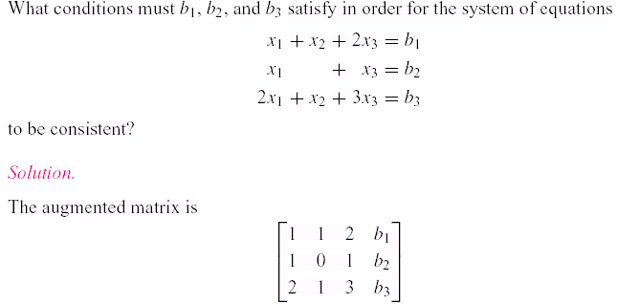
Example3
Determining Consistency by Elimination (1/2)

Slide 55

Example3
Determining Consistency by Elimination (2/2)

Slide 56

Example4
Determining Consistency by Elimination(1/2)

Slide 57

Example4
Determining Consistency by Elimination(2/2)

Slide 58
1.7 Diagonal, Triangular,
and Symmetric Matrices

Slide 59


Diagonal Matrices (1/3)
A square matrix in which all the entries off the main diagonal are zero is called a diagonal matrix . Here are some examples.
A general n×n diagonal matrix D can be written as

Slide 60


Diagonal Matrices (2/3)
A diagonal matrix is invertible if and only if all of its diagonal entries are nonzero;
Powers of diagonal matrices are easy to compute; we leave it for the reader to verify that if D is the diagonal matrix (1) and k
is a positive integer, then:

Slide 61

Diagonal Matrices (3/3)
Matrix products that involve diagonal factors are especially easy to compute. For example,
To multiply a matrix A on the left by a diagonal matrix D, one can multiply successive rows of A by the successive diagonal entries of D, and to multiply A on the right by D one can multiply successive columns of A by the successive diagonal entries of D .

Slide 62

Example1
Inverses and Powers of Diagonal Matrices

Slide 63
Triangular Matrices
A square matrix in which all the entries above the main diagonal are zero is called lower triangular .
A square matrix in which all the entries below the main diagonal are zero is called upper triangular .
A matrix that is either upper triangular or low r triangular is called triangular .

Slide 64


Example2
Upper and Lower Triangular Matrices

Slide 65

Theorem 1.7.1

Slide 66

Example3
Upper Triangular Matrices

Slide 67



Symmetric Matrices
A square matrix A is called symmetric if A= .
The entries on the main diagonal may b arbitrary, but “mirror images” of entries across the main diagonal must be equal.
a matrix is symmetric if and only if
for all values of i and j .

Slide 68

Example4
Symmetric Matrices

Slide 69


Theorem 1.7.2
Recall :
Since AB and BA are not usually equal, it follows that AB will
not usually be symmetric.
However, in the special case where AB=BA ,the product AB will
be symmetric. If A and B are matrices such that AB=BA ,then
we say that A and B commute .
In summary:
  The product of two symmetric matrices is symmetric if and
  only if the matrices commute .

Slide 70

Example5
Products of Symmetric Matrices
The first of the following equations shows a product of symmetric matrices that is not symmetric, and the second shows a product of symmetric matrices that is symmetric.
We conclude that the factors in the first equation do not commute, but those in the second equation do.

Slide 71

Theorem 1.7.3
If A is an invertible symmetric matrix ,then is symmetric.
  In general, a symmetric matrix need not be invertible.

Slide 72



Products
The products are both square matrices.
---- the matrix has size m×m and the matrix
has size n×n .
Such products are always symmetric since

Slide 73

Example6
The Product of a Matrix and Its Transpose Is Symmetric

Slide 74
Theorem 1.7.4
A is square matrix. If A is an invertible matrix ,then and are also invertible.

